Slide 1
Searching Year Calendar Group Name: MAKINTOS
Submitted by:
1. Shahed Hasan Shuvo ID:16172103030 2. Anika Tabassum ID:16172103003 3.Rakibul Hasan Hridoy ID:16172103022 4.Sakhawat Hossain ID:16172103046
Submitted to:
MR. SUDIP KUMAR HALDER
(LECTURER)
Department of CSE

Slide 2
Introduction:
A calendar is a system of organizing days for social, religious, commercial or administrative purposes. This is done by giving names to periods of time, typically days, weeks, months and years. A date is the designation of a single, specific day within such a system.

Slide 3

object of our project:
Search in any year.
Important day search.
Save any memorable days.

Slide 4

Project abstract:
The calendar project here is a very simple console application developed using c programming language.
It is built without using graphics properties.

Slide 5

Features:
The key features of this calendar project are:
Windows properties have been used to make the overall colorful and handling has been used in this project.
It provides a very simple interface and displays days, dates, months and years based on the input given by the user.

Slide 6

Warking:
At first, the user needs to provide year as input. Example: 2018. This displays the calendar for year 2018.
the application displays day corresponding to a given date.
It also displays day and dates corresponding to a particular month and year.

Slide 7
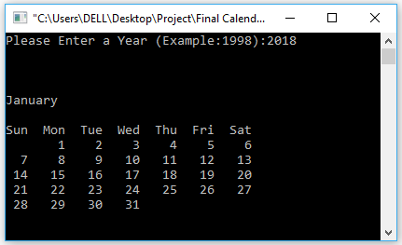
INPUT & output:
The simple input and output are:
Input: 10 / 01
Output: The return of Bangabandhu.
Input: 21 / 02
Output: International Mother Language Day.
Input: 26 / 03
Output: The Independence Day of Bangladesh.

Slide 8

Advantage of our project:
Let’s you see all your events at a quick glance.
Makes it easy to schedule new events. You know what’s already there.
Helps with scheduling blog posts and hosting guests. Useful to know when to send out questions, request them, or setup a reminder to answer and email them back.
Helps with setting writing deadlines.

Slide 9
Conclusion:
Finally, we can say that calendar is part and parcel of our life. We daily life used calendar. Calendar makes it easy for businesses to stay connected anytime and anywhere. Once set up, users can access the calendar, schedule meetings, and share with anyone they choose. At last say that a calendar is most importance in our life.

Slide 10
Thank you

